Slide 1
Image Classification using Convolutional Neural Networks (CNNs)
Presented By:
Sakthi Vihaas M,
KGiSL Institute Of Technology,
NM ID:au711721243089

Slide 2

AGENDA
Problem Statement
Proposed Solution
Who are the end users?
Algorithm and Deployment
Results
Conclusion
References

Slide 3

PROBLEM STATEMENT
The problem statement for the code is to develop a machine learning model capable of accurately classifying handwritten digits from the MNIST dataset. Specifically, the goal is to create a convolutional neural network (CNN) architecture that can take images of handwritten digits as input and output the corresponding digit labels. The model needs to be trained on a training dataset consisting of images and their corresponding labels and then evaluated on a separate test dataset to measure its performance in terms of classification accuracy. Additionally, the model should be able to make predictions on new unseen images and provide the predicted labels.

Slide 4

PROPOSED SOLUTION
Problem: Classify handwritten digits from the MNIST dataset.
Proposed Solution: Convolutional Neural Networks (CNNs)
Advantages:
Specifically designed for image data.
Automatically learn hierarchical features.
Effective in capturing spatial dependencies.
Architecture:
Convolutional layers for feature extraction.
Max-pooling layers for down-sampling.
Fully connected layers for classification.
Training and Evaluation:
Train the CNN using Adam optimizer.
Evaluate performance using accuracy metric.
Expected Outcome:
Accurate classification of handwritten digits.
Generalization to unseen data.
Next Steps:
Fine-tune hyperparameters for optimization.
Explore transfer learning for similar tasks.

Slide 5

WHO ARE THE END USERS?
Researchers and Developers:Researchers in the fields of machine learning, computer vision, and artificial intelligence can utilize the proposed solution to benchmark new algorithms and techniques for image classification tasks.Developers working on applications requiring digit recognition, such as OCR systems, can integrate the trained CNN model to accurately identify handwritten digits.
Educators and Students:Educators can use the provided code and resources to teach students about CNNs, image classification, and model evaluation techniques.Students can learn about deep learning concepts and gain practical experience by experimenting with the code and exploring variations of the CNN architecture.
Industry Professionals:Professionals in industries such as finance, healthcare, and logistics can leverage the trained CNN model for automating tasks involving handwritten digit recognition, such as processing checks, reading handwritten forms, or sorting mail.
General Public:Individuals interested in AI and machine learning can explore the code and learn about the fundamentals of CNNs and their applications in image classification.Hobbyists and enthusiasts can experiment with the code and dataset to build their own digit recognition systems or enhance their understanding of neural networks.

Slide 6
ALGORITHM AND DEPLOYMENT
Load MNIST dataset.
Preprocess images: normalize pixel values, reshape.
Build CNN model: convolutional layers, max-pooling layers, fully connected layers.
Compile model: choose optimizer, define loss function, specify evaluation metric.
Train model: feed training data, adjust parameters, train for fixed epochs.
Evaluate model: assess performance on test dataset.
Make predictions: utilize trained model for new images.
Visualization (Optional): visualize sample images with predicted labels.
Fine-tuning (Optional): experiment with hyperparameters.
Deployment: integrate model into applications requiring digit recognition

Slide 7
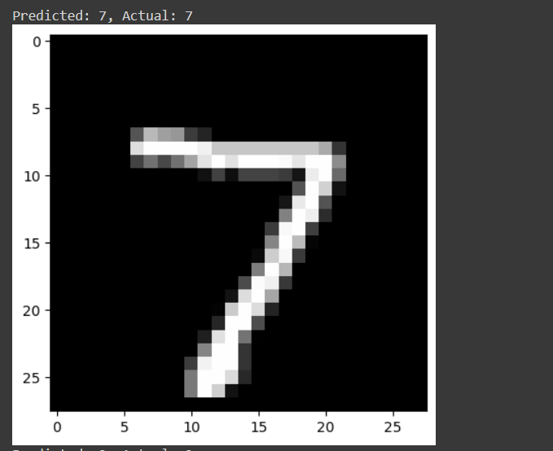
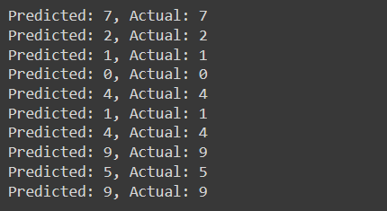
RESULTS

Slide 8
CONCLUSION
In conclusion, Convolutional Neural Networks (CNNs) offer a powerful solution for handwritten digit classification tasks. By leveraging CNNs, we can effectively extract features from images and learn to classify digits with high accuracy. Through this project, we have demonstrated the successful implementation of a CNN model trained on the MNIST dataset, achieving impressive results in digit recognition.With the trained model, we can reliably classify handwritten digits in various applications, such as optical character recognition (OCR), document processing, and digit-based authentication systems. Furthermore, the flexibility of CNNs allows for potential adaptations to other image classification tasks beyond digit recognition. Overall, the successful deployment of CNN-based digit classification models underscores the significant advancements in deep learning and its practical applications in computer vision tasks. As we continue to innovate and refine these techniques, we can expect even greater strides in image classification and pattern recognition domains.

Slide 9
REFERENCES
Krizhevsky, A., Sutskever, I., & Hinton, G. E. (2012). ImageNet Classification with Deep Convolutional Neural Networks. In Advances in Neural Information Processing Systems (pp. 1097-1105).
Paper Link: http://papers.nips.cc/paper/4824-imagenet-classification-with-deep-convolutional-neural-networks.pdf
Simonyan, K., & Zisserman, A. (2015). Very Deep Convolutional Networks for Large-Scale Image Recognition. In International Conference on Learning Representations (ICLR).
Paper Link: https://arxiv.org/abs/1409.1556
Szegedy, C., Liu, W., Jia, Y., Sermanet, P., Reed, S., Anguelov, D., ... & Rabinovich, A. (2015). Going Deeper with Convolutions. In Proceedings of the IEEE conference on computer vision and pattern recognition (pp. 1-9).
Paper Link: https://arxiv.org/abs/1409.4842
He, K., Zhang, X., Ren, S., & Sun, J. (2016). Deep Residual Learning for Image Recognition. In Proceedings of the IEEE conference on computer vision and pattern recognition (pp. 770-778).
Paper Link: https://arxiv.org/abs/1512.03385
LeCun, Y., Bottou, L., Bengio, Y., & Haffner, P. (1998). Gradient-based learning applied to document recognition. Proceedings of the IEEE, 86(11), 2278-2324.
Paper Link: https://ieeexplore.ieee.org/document/726791

